Slide 1
18CS822 Storage Area Network
Dr. S. Nandagopalan

Slide 2
Syllabus
Module 1 (8 hours)
Chapter 1: Storage System: Introduction to Information Storage: Information Storage, Evolution of Storage Architecture, Data Center Infrastructure, Virtualization and Cloud Computing.
Chapter 2: Data Center Environment: Application Database Management System (DBMS), Host (Compute), Connectivity, Storage, Disk Drive Components, Disk Drive Performance, Host Access to Data, Direct-Attached Storage, Storage Design Based on Application

Slide 3
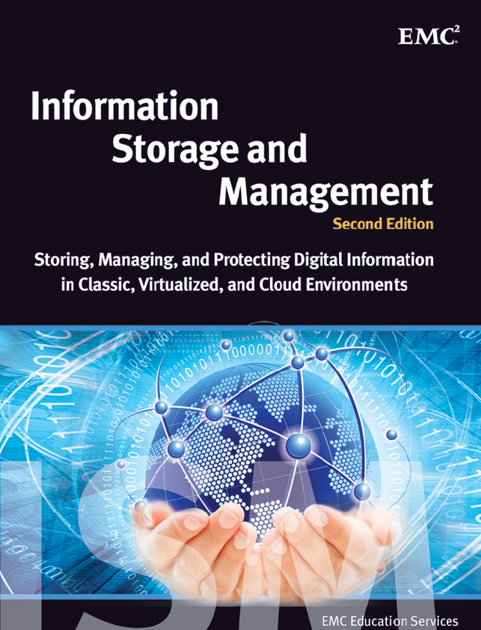
Text Book
EMC Education Services, “Information Storage and Management”, Wiley India Publications, 2009.
ISBN: 9781118094839

Slide 4
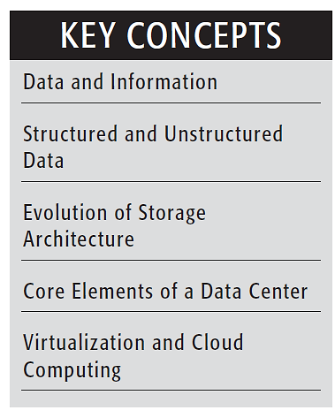
Key Concepts
What is SAN?
A SAN (storage area network) is a network of storage devices that can be accessed by multiple servers or computers, providing a shared pool of storage space. Each computer on the network can access storage on the SAN as though they were local disks connected directly to the computer.
Evolution of information storage architecture from a server-centric model to an information-centric model.

Slide 5
Introduction
We have become information dependent in the 21st century, living in an on-command, on-demand world.
Internet browsing, Social networking, e-mail, pictures, videos, etc.
information resides locally on devices, such as cell phones, smartphones, tablets, cameras, and laptops.
When shared, this information needs to be uploaded to central data repositories (data centers) via networks.
A data center is a facility that contains information storage and other physical information technology (IT) resources for computing, networking, and storing information.

Slide 6
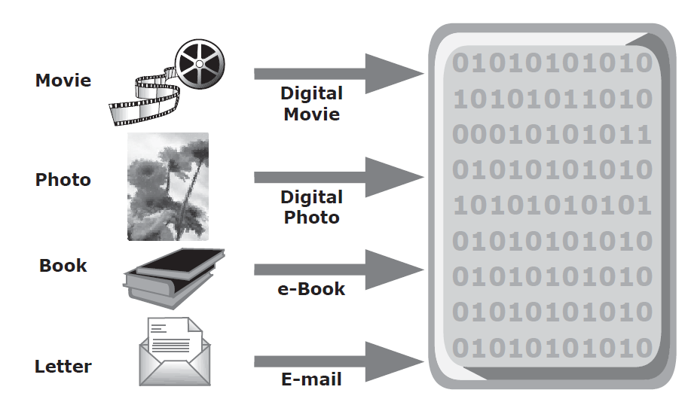
Information Storage
Organizations process data to derive the information required for their day-today operations.
Storage is a repository that enables users to persistently store and retrieve this digital data.
Data: is a collection of raw facts from which conclusions might be drawn.
Digital data ->

Slide 7
Growth of Digital Data
Factors that have contributed to the growth of digital data:
Increase in data-processing capabilities
Lower cost of digital storage
Affordable and faster communication technology
Proliferation of applications and smart devices
data explosion

Slide 8
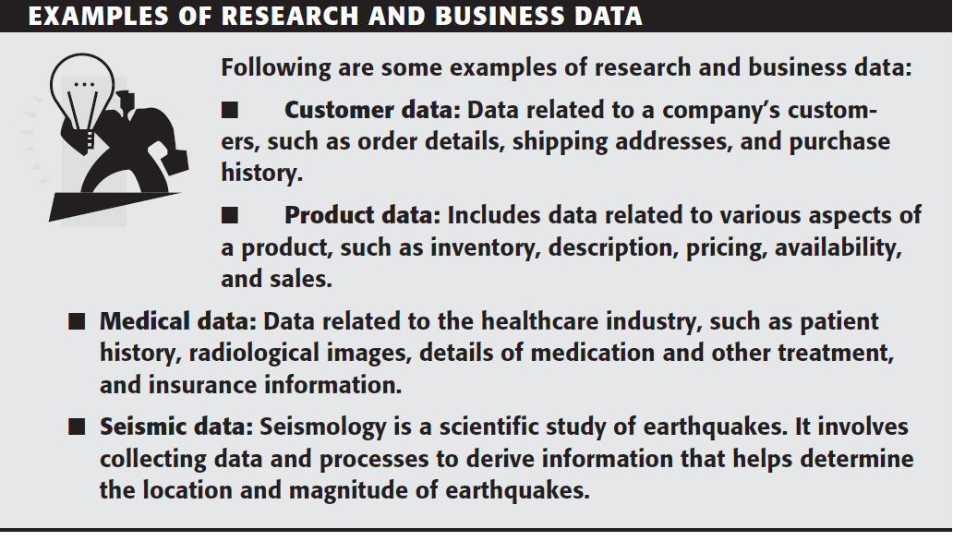

Slide 9
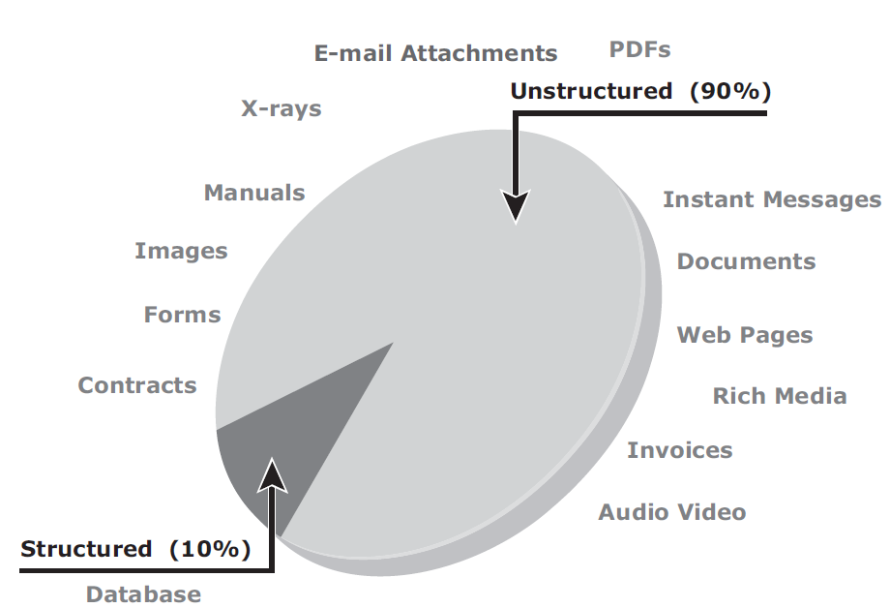
Types of Data
Structured or Unstructured

Slide 10
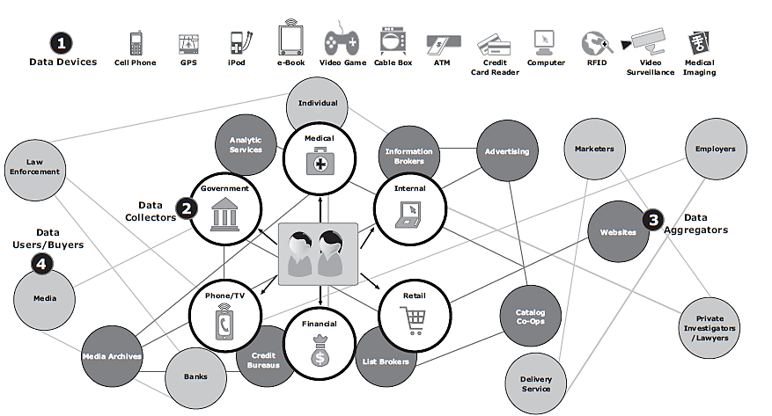
Big Data Ecosystem
big data ecosystem

Slide 11
Big Data Ecosystem
1. Devices that collect data from multiple locations and also generate new data about this data (metadata).
2. Data collectors who gather data from devices and users.
3. Data aggregators that compile the collected data to extract meaningful information.
4. Data users and buyers who benefit from the information collected and aggregated by others in the data value chain.

Slide 12
Information
Information is the intelligence and knowledge derived from data.
Businesses analyze raw data to identify meaningful trends
Customers’ preferred products and brand names by analyzing their purchase patterns
Potential for new business opportunities by using the information

Slide 13
Storage
Data created by individuals or businesses must be stored so that it is easily accessible for further processing.
In a computing environment, devices designed for storing data are termed storage devices or simply storage
CDs, DVDs, HDDs, etc.

Slide 14
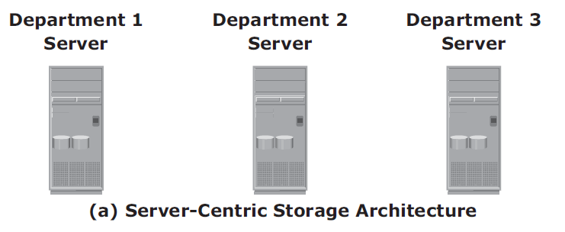
Evolution of Storage Architecture
server-centric storage architecture

Slide 15
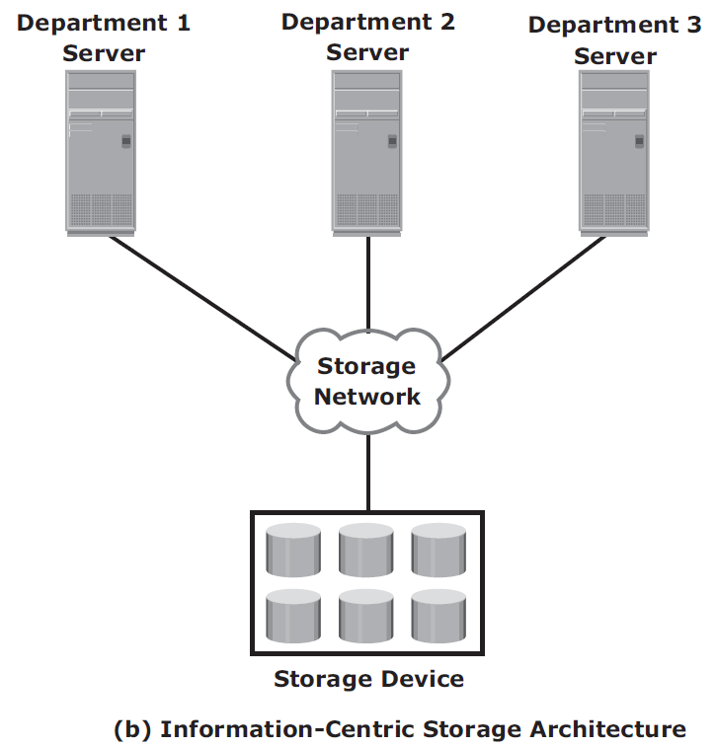
Evolution of Storage Architecture…
information-centric storage architecture

Slide 16
Data Center Infrastructure
Organizations maintain data centers to provide centralized data-processing capabilities across the enterprise.
Data centers house and manage large amounts of data.
The data center infrastructure includes hardware components, such as computers, storage systems, network devices, and power backups; and software components, such as applications, operating systems, and management software

Slide 17
Core Elements of a Data Center
Application: A computer program that provides the logic for computing Operations
Database management system (DBMS): Provides a structured way to store data in logically organized tables that are interrelated
Host or compute: A computing platform (hardware, firmware, and software) that runs applications and databases
Network: A data path that facilitates communication among various networked devices
Storage: A device that stores data persistently for subsequent use

Slide 18
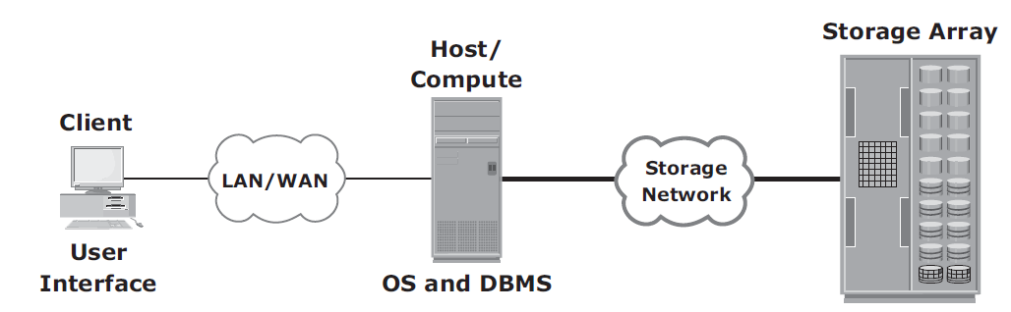
Online order transaction system

Slide 19
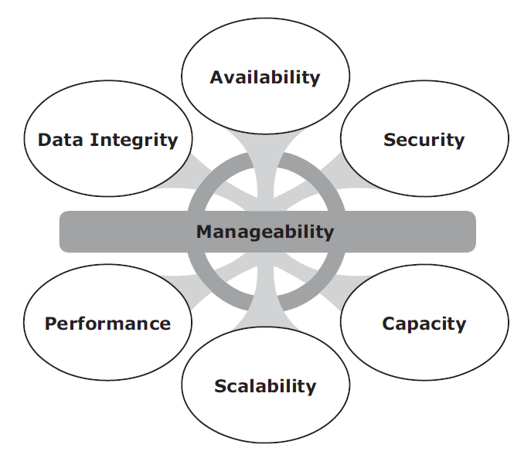
Key Characteristics of a Data Center

Slide 20
Managing a Data Center
Monitoring: It is a continuous process of gathering information on various elements and services running in a data center.
Reporting: It is done periodically on resource performance, capacity, and utilization
Provisioning: It is a process of providing the hardware, software, and other resources required to run a data center.

Slide 21
Virtualization and Cloud Computing
Virtualization is a technique of abstracting physical resources, such as compute, storage, and network, and making them appear as logical resources
Virtualization enables pooling of physical resources and providing an aggregated view of the physical resource capabilities.
E.g. Storage, CPU, etc.
Cloud computing - enables individuals or businesses to use IT resources as a service over the network.
Provides highly scalable and flexible computing (resources on demand).
Users can scale up or scale down the demand of computing resources, including storage capacity, with minimal management.

Slide 22
Chapter 2: Data Center Environment

Slide 23
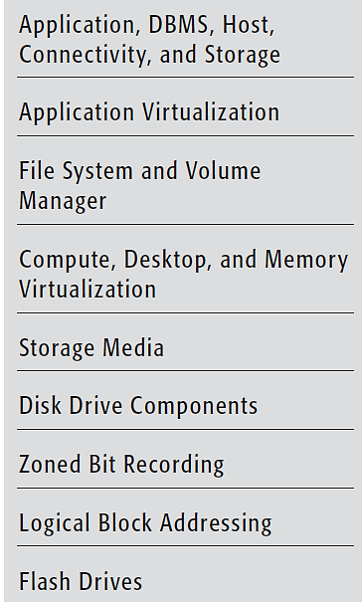
Key Concepts

Slide 24
Application
An application is a computer program that provides the logic for computing operations.
The application sends requests to the underlying operating system to perform read/write (R/W) operations on the storage devices.
Applications can be layered on the database, which in turn uses the OS services to perform R/W operations on the storage devices.
Business applications, infrastructure management applications, data protection applications, and security applications
E.g. ERP, DSS, resource management, backup, authentication and antivirus applications

Slide 25
Application Virtualization
Application virtualization - breaks the dependency between the application and the underlying platform (OS and hardware).
Application virtualization encapsulates the application and the required OS resources within a virtualized container.
Deploy applications without making any change to the underlying OS, file system, or registry of the computing platform

Slide 26
Basic Concepts
DBMS
HOST
OS
Memory Virtualization
Device Driver

Slide 27
Volume Manager
LVM (Logical Volume Manager) - dynamic extension of file system capacity and efficient storage management
LVM is software that runs on the compute system and manages logical and physical storage.
LVM is an intermediate layer between the file system and the physical disk
Partitioning - a larger-capacity disk divided into virtual, smaller-capacity volumes
Disk partitioning
Concatenation - aggregate several smaller disks to form a larger virtual volume.

Slide 28
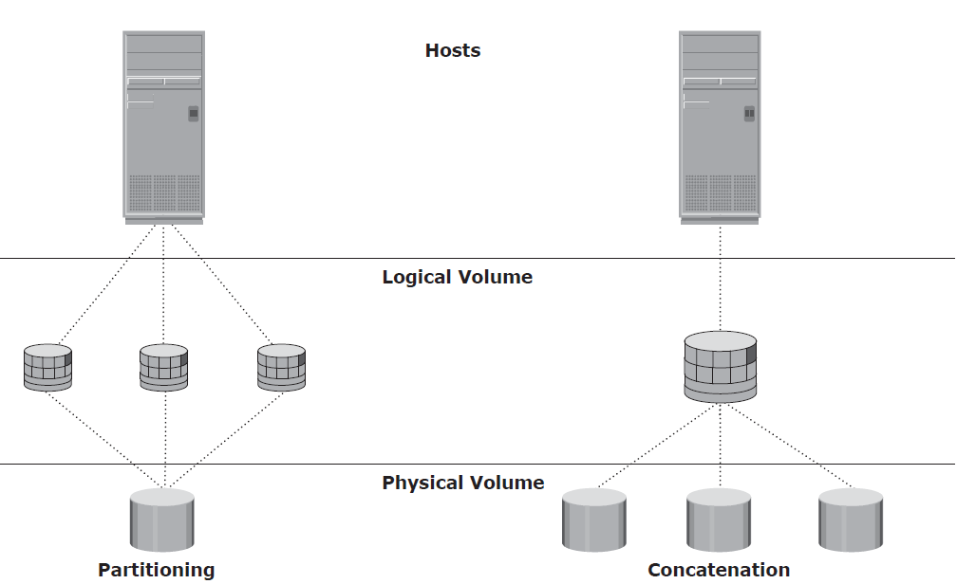
Disk partitioning and concatenation

Slide 29
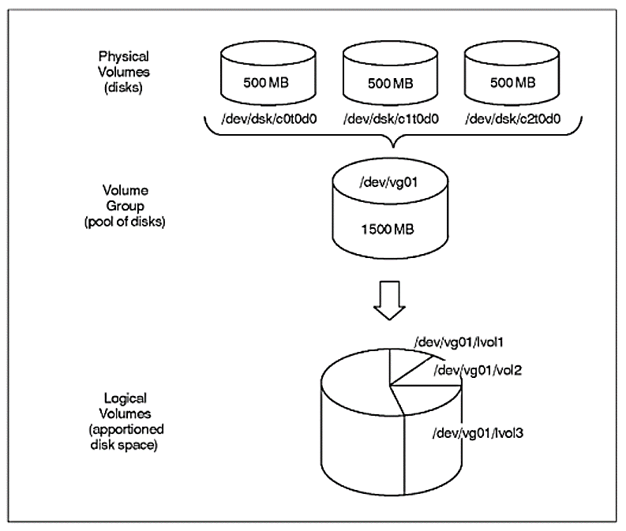
Disk space partitioned into LV

Slide 30
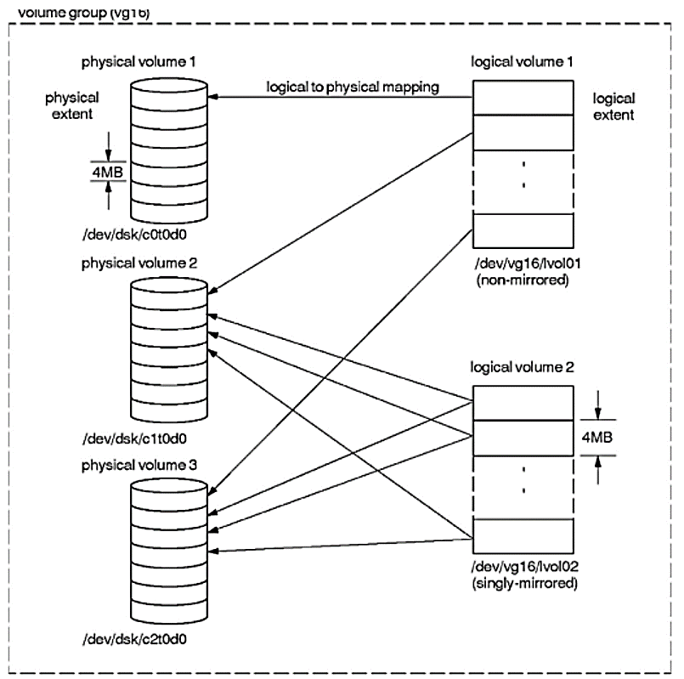
Physical and Logical Extents

Slide 31
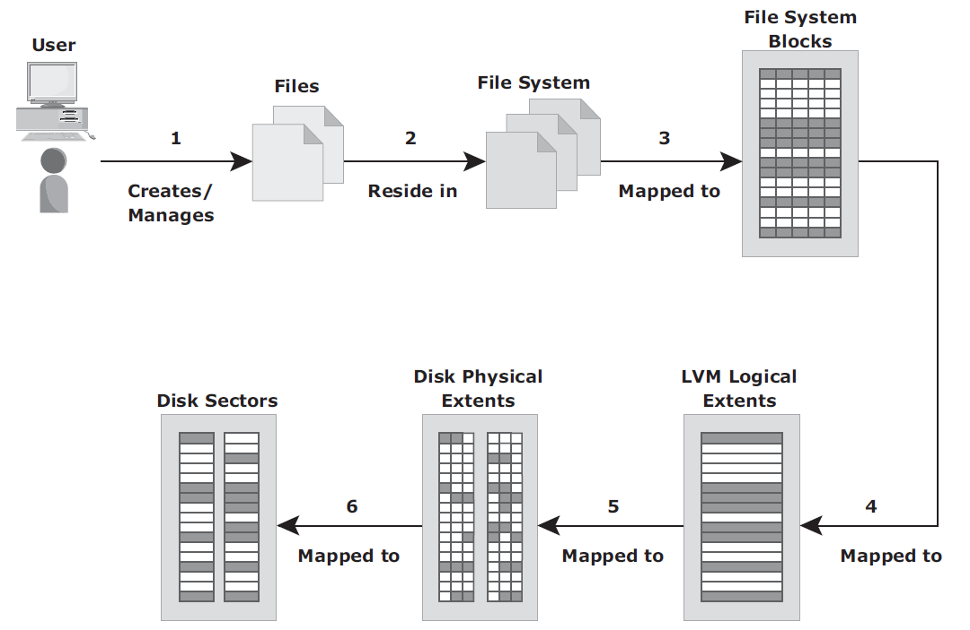
Files to Disk
file - a collection of related records
file system - a hierarchical structure of files - logical structures (FAT32, NTFS, LINUX)
extents - each volume within a volume group is segmented into small, fixed-size chunks

Slide 32
Process of mapping user files to the disk storage
1. Files are created and managed by users and applications.
2. These files reside in the file systems.
3. The file systems are mapped to file system blocks.
4. The file system blocks are mapped to logical extents of a logical volume.
5. These logical extents in turn are mapped to the disk physical extents either by the operating system or by the LVM.
6. These physical extents are mapped to the disk sectors in a storage subsystem.

Slide 33
Compute Virtualization
Compute virtualization is a technique for masking or abstracting the physical hardware from the operating system.
It enables multiple operating systems and applications to run concurrently on single or clustered physical machines.
This technique enables creating portable virtual compute systems called virtual machines (VMs).
Thin Clients vs. VMs?

Slide 34
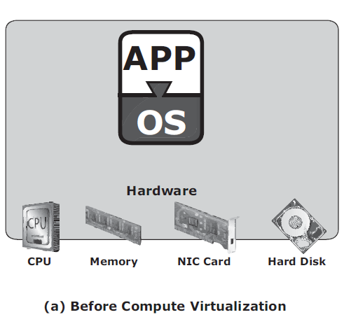
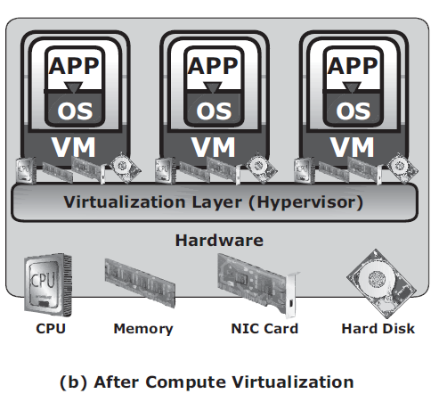
Server Virtualization

Slide 35
Connectivity
Connectivity refers to the interconnection between hosts or between a host and peripheral devices, such as printers or storage devices
Interface Protocols – self study

Slide 36
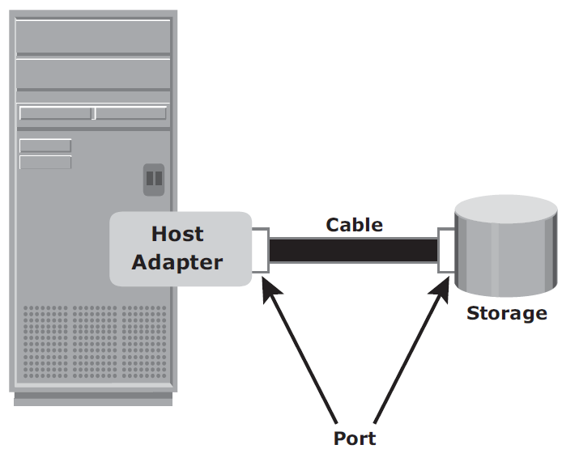
Physical Components of Connectivity

Slide 37
Storage
Storage is a core component in a data center.
Disks, tapes, and diskettes, CD/DVD, etc.

Slide 38
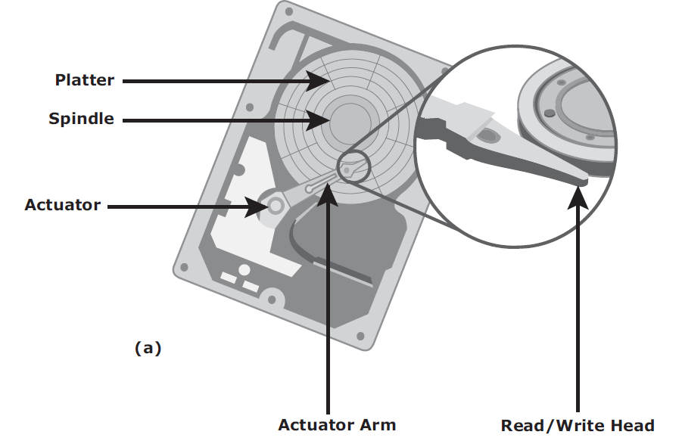
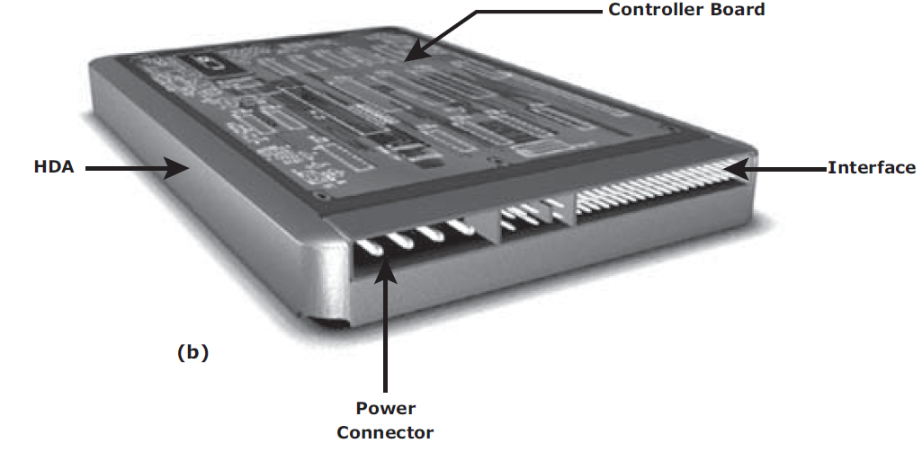
Disk Drive Components

Slide 39
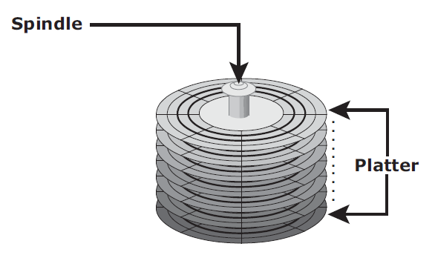
Platter & Spindle
A typical HDD consists of one or more flat circular disks called platters (contains binary data)
A spindle connects all the platters and is connected to a motor.
The motor of the spindle rotates with a constant speed.
Common spindle speeds are 5,400 rpm, 7,200 rpm, 10,000 rpm, and 15,000

Slide 40
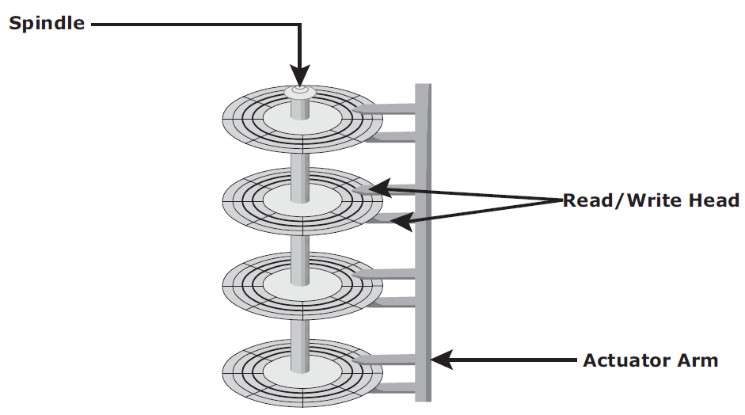
Read/Write Head
Drives have two R/W heads per platter, one for each surface of the platter.
The R/W head will not touch the platter, but maintains air gap - head flying height

Slide 41
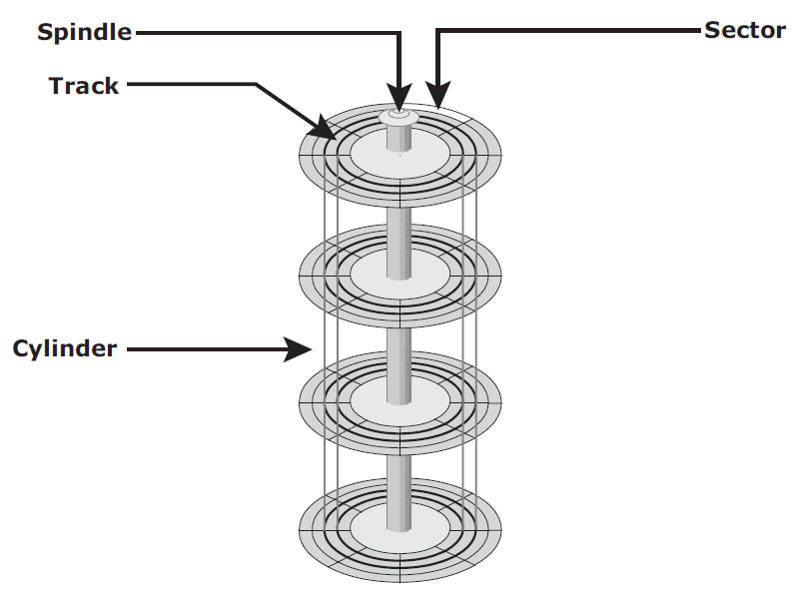
Physical Disk Structure
Data on the disk is recorded on tracks, which are concentric rings on the platter around the spindle.
Each track is divided into smaller units called sectors.
A sector is the smallest, individually addressable unit of storage (512B).
A cylinder is a set of identical tracks on both surfaces of each drive platter.
The location of R/W heads is referred to by the cylinder number, not by the track number.

Slide 42
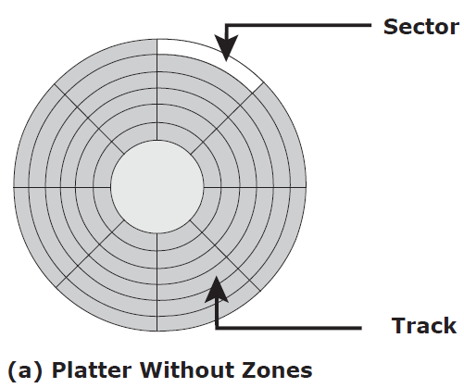
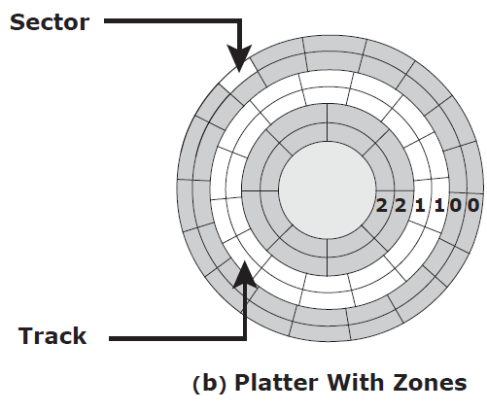
Zoned Bit Recording
Zones – grouping of tracks

Slide 43
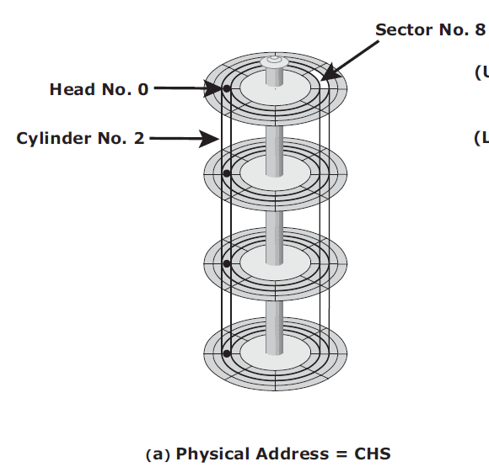
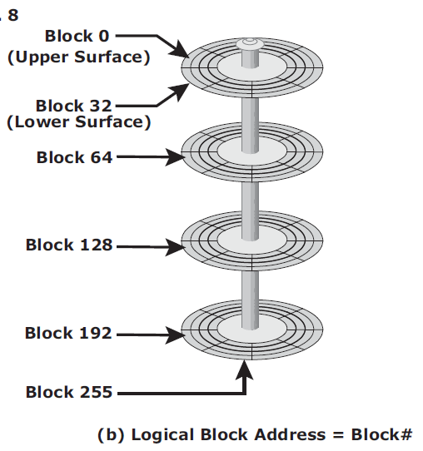
Logical Block Addressing
Physical addresses consisting of the cylinder, head, and sector (CHS) number to refer to specific locations on the disk
Logical block addressing (LBA) - addressing by using a linear address to access physical blocks of data.
# sectors/track = 8
# heads = 8
# cylinders = 4
# blocks = 8x8x4 = 256 blocks
500GB HDD – 976,000,000 blocks

Slide 44
Disk Drive Performance
Factors that affect the performance of disk drives
Disk service time is the time taken by a disk to complete an I/O request
Disk Service Time
Seek Time
Rotational Latency
Data Transfer Rate
Disk I/O Controller Utilization

Slide 45
(1) Seek Time
Time taken to position and settle and the R/W head over the correct track.
Average seek time on a modern disk is in the range of 3 to 15 milliseconds.
Full Stroke: The time taken by the R/W head to move across the entire width of the disk, from the innermost track to the outermost track.
Average: The average time taken by the R/W head to move from one random track to another, normally listed as the time for one-third of a full stroke.
Track-to-Track: The time taken by the R/W head to move between adjacent tracks.

Slide 46
(2) Rotational Latency
The time taken by the platter to rotate and position the data under the R/W head is called rotational latency.
Average rotational latency for a 15,000 rpm (or 250 rps) drive = 0.5/250 = 2 milliseconds.

Slide 47
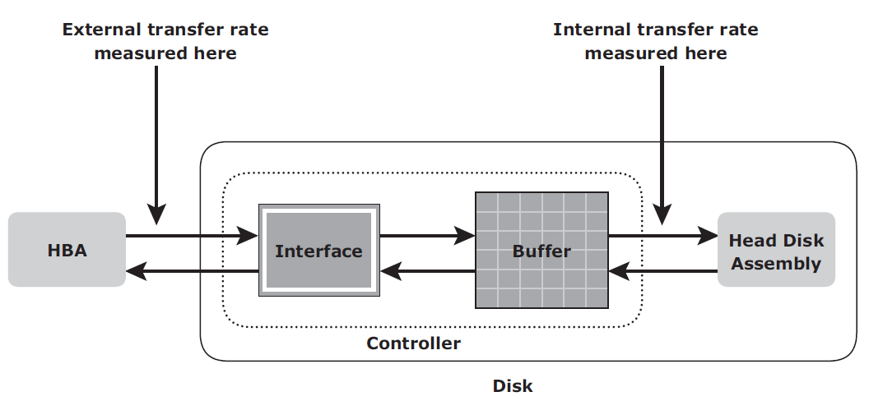
(3) Data Transfer Rate
The average amount of data per unit time that the drive can deliver to the Host Bus Adaptor (HBA)
The data transfer rates during the R/W operations are measured in terms of internal and external transfer rates.

Slide 48
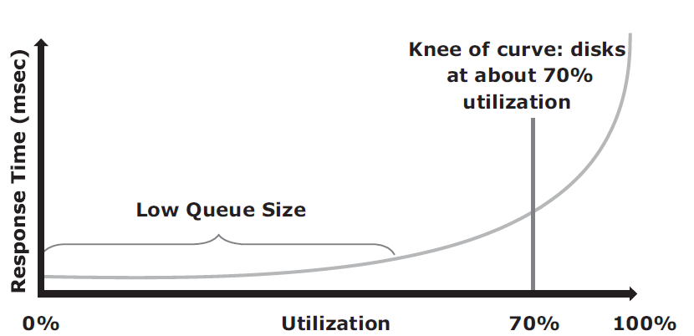
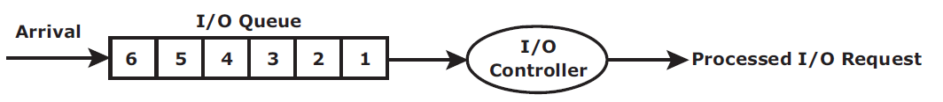
Disk I/O Controller Utilization
A disk can be viewed as a black box consisting of two elements:
Queue: The location where an I/O request waits before it is processed by the I/O controller
Disk I/O Controller: Processes I/Os waiting in the queue one by one

Slide 49
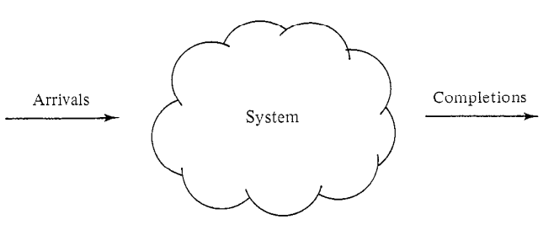
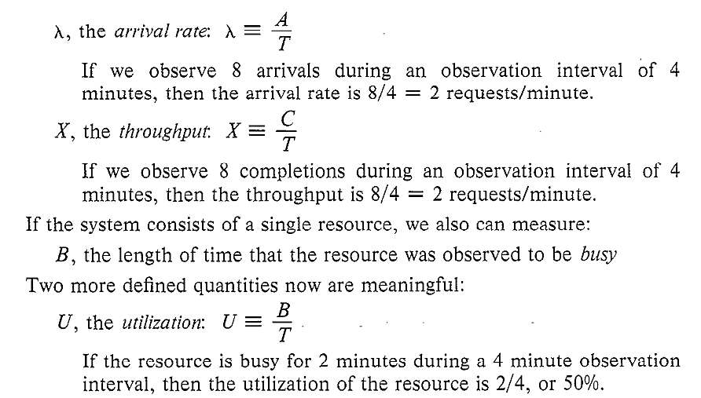
What is Utilization?
T - the length of time we observed the system
A - the number of request arrivals we observed
C - the number of request completions we observed
Example:
consider a disk that is serving 40 requests/second, each of which requires .0225 seconds of disk service.
utilization = 40x .0225 = 90%.

Slide 50
Host Access to Data
Data is accessed and stored by applications using the underlying infrastructure
Step 1: application requests data from the file system
Step 2: file system maps the file attributes to the logical block address of the data
Step 3: the request is sent to the storage device
Step 4: storage device converts the logical block address (LBA) to a cylinder-head-sector (CHS) address and fetches the data

Slide 51
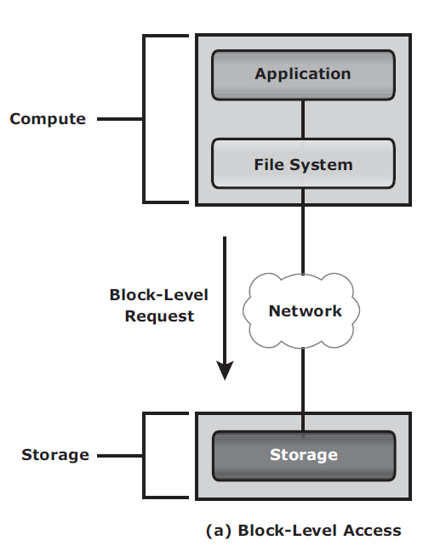
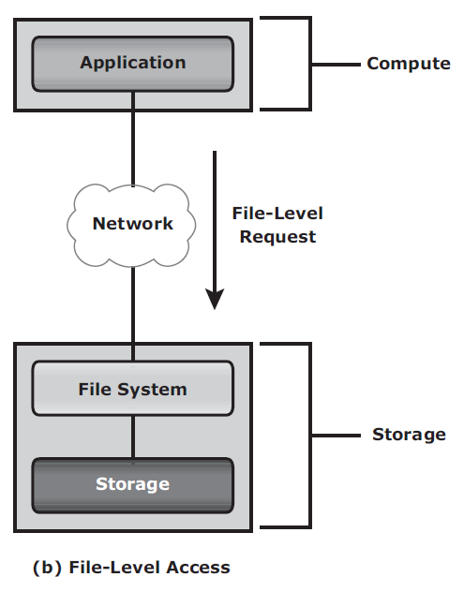
Host Access
Block-level access - the file system is created on a host, and data is accessed on a network at the block level.
File-level access - the file system is created on a separate file server or at the storage side

Slide 52
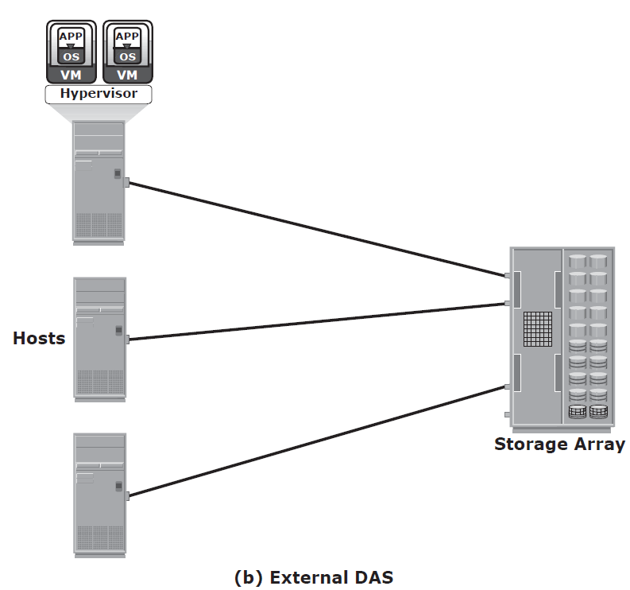
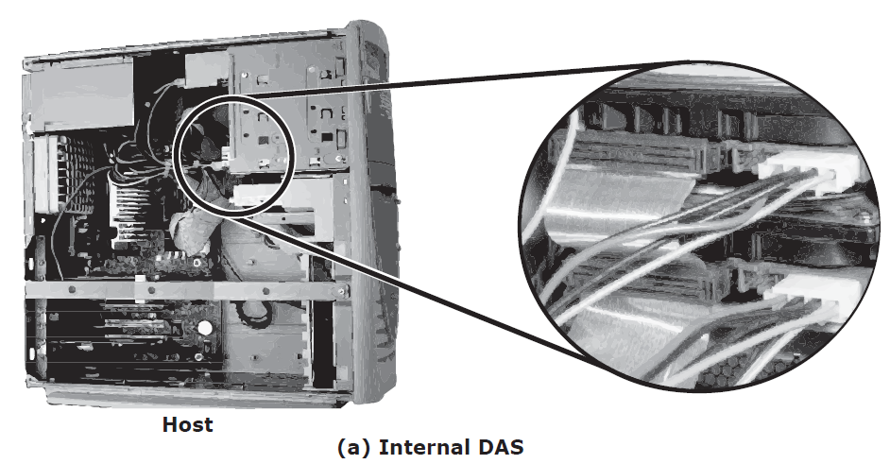
Direct-Attached Storage
direct-attached storage (DAS) - the storage is connected directly to the host
E.g. Internal disks drive, external storage array

Slide 53
Benefits of DAS
Less expensive (cheaper)
Simple
Rapid deployment
Setup is based on OS
Less H/W and S/W
Management is easier

Slide 54
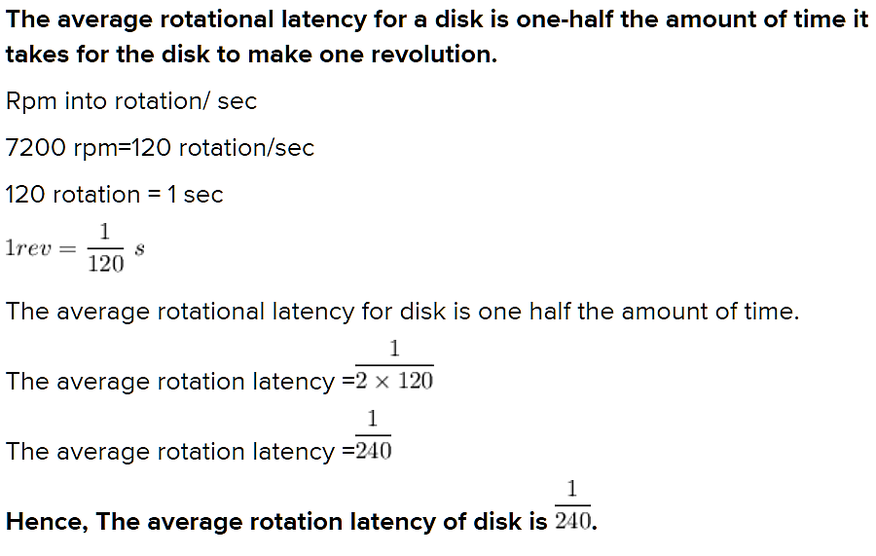
Computing Rotational Latency
What is the average rotational latency of a disk drive that rotates at 7200 rpm?

Slide 55
Storage Design Based on Application Requirements and Disk Performance
How much storage required for an application?
Solution: size and number of file systems and database components used by applications
I/O characteristics – Block size of DBMS
Disk Service Time = T_{S} = T + L + X
T - seek time, L - rotational latency, X – internal transfer Time
Example: T = 5 ms.
Disk rotation speed of 15,000 revolutions per minute or 250 revolutions per second,
So L = 0.5/250 (to cover half of a rotation when calculating an average time for rotation)
X = 32 KB/40 MB, assume Data Transfer rate = 40 MB/s & block size is 32KB
Hence, T_{S} = 5 ms + (0.5/250) + 32 KB/40 MB = 7.8 ms
Maximum number of I/Os serviced per second or IOPS is
(1/T_{S}) = 1/(7.8 × 10⁻³) = 128 IOPS
Compute X:
40MB-----1 sec
32KB ----- ?

Slide 56
How to compute storage?
Response Time = R = T_{S}/(1 – U) = 7.8/(1 – 0.96) = 195 ms
If the application demands a faster response time, then the utilization for the disks should be maintained below 70 percent (R = 26ms)
The storage requirement for an application is determined in terms of both the capacity and IOPS
When an application demands for more storage, single may not provide.
total number of disks required (D_{R}) for an application is = Max (D_{C}, D_{I})
D_{C} – no. of disks required for capacity, D_{I} – for IOPS

Slide 57
Example
Capacity requirement for an application is 1.46 TB.
The number of IOPS generated by the application at peak workload is estimated at 9,000 IOPS.
The vendor specifies that a 146-GB, 15,000-rpm drive is capable of doing a maximum 180 IOPS.
The number of disks required to meet the capacity requirements will be 1.46 TB/146 GB = 10 disks.
To meet the application IOPS requirements, the number of disks required is 9,000/180 = 50 disks
Considering 70% utilization, 180x0.7 = 126 IOPS
Hence, # of disks required is = 9000/126 = 72 disks

Slide 58
Review Questions
Explain evolution of storage architecture with an example (15CS754 Feb 2021)
Discuss the key characteristics of a data center with an example (15CS754 Feb 2021, 17CS754 Feb 2021 and 15CS754 Aug 2020)
Explain the core elements of Data Center
Discuss the process of mapping user files to disk storage with a neat diagram (17CS754 Feb 2021)
With a neat diagram explain the structure of read write operations in cache (15CS754 Feb 2021)

Slide 59
Exercises
What are the advantages of a virtualized data center over a classic data center?
Explain the physical disk structure and logical block addressing with neat diagrams.
Discuss various factors that would affect the performance of disk drives.
An application specifies a requirement of 200 GB to host a database and other files. It also specifies that the storage environment should support 5,000 IOPS during its peak workloads. The disks available for configuration provide 66 GB of usable capacity, and the manufacturer specifies that they can support a maximum of 140 IOPS. The application is response time sensitive, and disk utilization beyond 60 percent does not meet the response time requirements. Compute and explain the theoretical basis for the minimum number of disks that should be configured to meet the requirements of the application.

Slide 60
Exercises
The average I/O size of an application is 64 KB. The following specifications are available from the disk manufacturer: average seek time = 5 ms, 7,200 RPM, and transfer rate = 40 MB/s. Determine the maximum IOPS that could be performed with this disk for the application. Using this case as an example, explain the relationship between disk utilization and IOPS.

